Slide 1



Module 4 Azure Active Directory
Section 5 - Web Sign-in protocols & Security Tokens
June 2018
WS-Federation

Slide 2
Agenda – Module 4 – Section 5 - Web Sign-in protocols & Security Tokens
01
Azure AD Authentication protocols Overview of the supported Azure AD Authentication protocols
02
Oauth 2.0 A detailed description of the Oauth 2.0 authorization protocol (key terms and the main flows scenarios)
03
OpenID Connect Introduction to OpenID Connect which brings an identity layer on top of OAuth 2.0
04
SAML Introduction to the SAML concepts and the web sso flow
05
WS-Federation Quick overview about the mains goals
06
Security Tokens Overview of the different flavors of Security Tokens used in the different protocols

Slide 3
Azure AD : Web Sign-in Protocols
OAuth 2.0
Authorizes access to Web Applications and WebAPIs
Registering the application gives Application ID and enables it to receive
Read more
OpenID Connect
Simple identity layer built on top of the OAuth 2.0 protocol
Defines mechanisms to obtain and use access tokens to access protected resources
Implements authentication as an extension to the OAuth 2.0 authorization process
Format is JSON Read more
SAML 2.0
Azure AD uses the SAML 2.0 protocol to provide SSO Experience
SAML profiles of Azure AD explain how assertions, protocols and bindings are used
Read more
WS-Federation (Liberty Alliance)
Defines how trust should be brokered between parties (through an STS)
Defines two profiles : Active Requestor Profile / Passive Requestor Profile
Token Agnostic
Notes:
Azure AD supports the OAuth 2.0 authorization protocol, which makes use of both access_tokens and refresh_tokens. It also supports authentication and sign-in via OpenID Connect, which introduces a third type of token, the id_token. Each of these tokens is represented as a "bearer token."
Azure Active Directory (Azure AD) uses OAuth 2.0 to enable you to authorize access to web applications and web APIs in your Azure AD tenant
When you register your application with Azure AD, it gives you…
A bearer token is a lightweight security token that grants the “bearer” access to a protected resource. In this sense, the “bearer” is any party that can present the token. Though authentication with Azure AD is required in order to receive a bearer token, steps must be taken to secure the token, to prevent interception by an unintended party. Because bearer tokens do not have a built-in mechanism to prevent unauthorized parties from using them, they must be transported in a secure channel such as transport layer security (HTTPS). If a bearer token is transmitted in the clear, a man-in the middle attack can be used to acquire the token and gain unauthorized access to a protected resource. The same security principles apply when storing or caching bearer tokens for later use. Always ensure that your app transmits and stores bearer tokens in a secure manner.
Reference
Aka.ms/Azure/Protocols
https://docs.microsoft.com/en-us/azure/active-directory/develop/active-directory-v2-protocols

Slide 4


OAuth (Open Authorization)
Open-standard protocol to provide simple and secure authorization for applications
The OAuth 2.0 authorization framework enables a third-party application (a client app) to obtain limited access to an HTTP service (resource server), either on behalf of a resource owner (user) by orchestrating an approval interaction between the resource owner and the HTTP service (via an Authorization server), or by allowing the third-party application to obtain access on its own behalf.
Safe and simple method for consumers to interact with protected data
Allows to give access to services without exchanging credentials
ADVANTAGES
Flexible and compatible with mobile devices and applications
Has support from the industry
Provides limited access in terms of scope and duration
Notes:
OAUTH
Delegates access to a user’s resources to your service or application.
Limited and controlled -- granted by the user
Doesn’t require the user to share their password
Your app gets its own delegation credential (access token)
Open Protocol – RFC5849, RFC6749 and RFC6750
Azure AD supports the OAuth 2.0 authorization protocol, which makes use of both access_tokens and refresh_tokens. It also supports authentication and sign-in via OpenID Connect, which introduces a third type of token, the id_token. Each of these tokens is represented as a "bearer token."
Azure Active Directory (Azure AD) uses OAuth 2.0 to enable you to authorize access to web applications and web APIs in your Azure AD tenant
When you register your application with Azure AD, it gives you…
A bearer token is a lightweight security token that grants the “bearer” access to a protected resource. In this sense, the “bearer” is any party that can present the token. Though authentication with Azure AD is required in order to receive a bearer token, steps must be taken to secure the token, to prevent interception by an unintended party. Because bearer tokens do not have a built-in mechanism to prevent unauthorized parties from using them, they must be transported in a secure channel such as transport layer security (HTTPS). If a bearer token is transmitted in the clear, a man-in the middle attack can be used to acquire the token and gain unauthorized access to a protected resource. The same security principles apply when storing or caching bearer tokens for later use. Always ensure that your app transmits and stores bearer tokens in a secure manner.

Slide 5
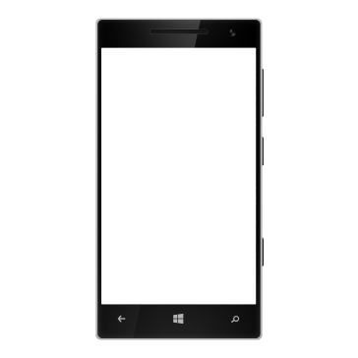

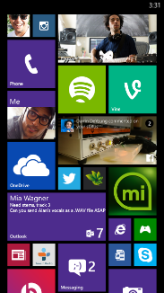


Standard Roles in OAuth 2.0
John’s App
John’s Data
RESOURCE
SERVER
Client Application
An application making a resource request
Application using APIs to perform actions on the resource
Example: A word app on your mobile phone
Authorization Server
Server that verify identity before issuing access tokens
Gets access consent from the resource owner
Example: Typically an Identity provider
Resource Server
Server hosting protected resources
Typically an API provider
Example: Sharepoint online
Resource Owner
Entity capable of granting access to the protected resource
One who Owns the resource
Typically a user of an application
Example: You are the owner of your documents in your SharePoint online site.
CLIENT
4. Get Data
3. Issue Token
1.
RESOURCE
OWNER
AUTHORIZATION
SERVER
2. Authenticate and Consent
John
Azure AD

Slide 6
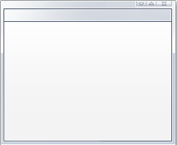
OAauth Client types
Clients application access a service on behalf of a user, 2 Client app types :
Public client app
Runs locally on a device. Not trusted to hold a secret.
Mostly native/desktop applications or user-agent-based applications (javascript application running in a browser).
Private/Confidential client app
Can be trusted with secrets.
A client capable of keeping a secret (typically server applications, not in end-user's hands)
Mostly web apps (confidential server-based component)
Web Server
John
Client Application or web App
Web Service
John’s Device
Notes:
Confidential client
Clients capable of maintaining the confidentiality of their credentials (e.g., client implemented on a secure server with restricted access to the client credentials) or
Capable of secure client authentication using other means.
Public client
Clients incapable of maintaining the confidentiality of their credentials (e.g., clients executing on the device used by the resource owner, such as an installed native application or a web browser-based application), and
Incapable of secure client authentication via any other means

Slide 7
OAUTH Client App Profiles
Web Application
Is a confidential client running on a web server
Resource owners access the client via an HTML user interface rendered in a user-agent on the device used by the resource owner
The client app credentials as well as any access token issued to the client are stored on the web server and are not exposed to or accessible by the resource owner.
User-agent-based Application
Is a public client in which the client code is downloaded from a web server and executes within a user-agent (e.g., web browser) on the device used by the resource owner
Protocol data and credentials are easily accessible (and often visible) to the resource owner
Since such applications reside within the user-agent, they can make seamless use of the user-agent capabilities when requesting authorization.
Native Application
Is a public client installed and executed on the device used by the resource owner
Protocol data and credentials are accessible to the resource owner
It is assumed that any client authentication credentials included in the application can be extracted
On the other hand, dynamically issued credentials such as access tokens or refresh tokens can receive an acceptable level of protection
At a minimum, these credentials are protected from hostile servers with which the application may interact
On some platforms, these credentials might be protected from other applications residing on the same device

Slide 8
Client App Registration
For most scenarios, the Client app needs to be registered with the Authorization Server in advance
Ensure that the client is a known and trusted entity
Generates a client identifier
Establish an authentication secret between the Client and Authorization Server
Client must provide
Client type : Public / Private
Allowed redirection URI’s (where to send the Tokens)
Other information such as name, website, description, logos, etc.
After registering, the authorization server will provide the client :
Client ID
Client Secret

Slide 9
OAUTH Endpoints
Two 'Authorization Server' endpoints
Authorization Endpoint
End-user facing
User authenticates and grants consent
This is normally a web page with a login and password box
Token Endpoint
Used for obtaining an access token
Typically a web service
One Client Endpoint
Redirect Endpoint
Client listens for authorization code
Used in the authorization code grant scenario

Slide 10
OAuth 2.0 Flows
Authorization Code
Server-side web applications (e.g. A web application that requires information from O365 API on your behalf)
One-time code issued to client / Client redeems code for access token
Client Web app : Request/redirects Authorization / Request Access Token / uses Access Token to access Resource
Implicit
Used for client-side web apps running in the browser (JavaScript, Flash, Silverlight etc.)
Client is untrusted (public)
No refresh token issued
Resource Owner Password Credentials
Highly-trusted clients, such as mobile client applications from the Resource Server (e.g. the authorized Native Mobile client)
Client collects username/password from user (resource owner)
Then exchange username/password for access token (Request token with resource owner credentials)
Client Credentials
Clients that can use resources irrespective of Resource Owner authorization – Client to service communication
Authenticates the client, not the user !
Client receives an access token for itself
Authorization Grant
An authorization grant is a “credential” representing the resource owner’s authorization (to access its protected resources) used by the client app to obtain an access token.
RFC 6749 defines four Authorization Grant Types
Notes:
Authorization Code Flow:
The standard flow. A user is redirected to the authorization server where they log in, and is then presented with an authorization form.
After authorization has been confirmed, the authorization server redirects back to the client with an authorization code.
The client then does an authorization code request with their full client credentials (client key and client secret) as well as the received code, and is given an access token (along with its expiry time and a refresh token).
=> requires intermediate credentials (the authorization code).
Client Credentials:
Used to authenticate the client (instead of asking for authorization from the user). In this case, services does not know who the current user is. Usually used for administration tasks specific to the client.
=> Clients request an access token using only their credentials. Useful for accessing protected resources they already have permission to access. For private clients only.
Resource Owner Password credentials:
OAuth 2 also provides a "password" grant type which can be used to exchange a username and password for an access token directly. Since this obviously requires the application to collect the user's password, it should only be used by apps created by the service itself. For example, the native Twitter app could use this grant type to log in on mobile or desktop apps.
=>Client receives the resource owner’s credentials and exchanges those directly for a token. Only suitable for migration purposes/high trust apps.
Implicit Flow:
The flow intended for pure-JS applications. A user is redirected to the authorization server where he logs in, and is then presented with an authorization form After authorization has been confirmed, the authorization server redirects back to the client with an access token.
The difference here is that there is no authorization code and a future authorization_code grant request, but instead an access token is immediately received.
=> no need for intermediate credentials

Slide 11



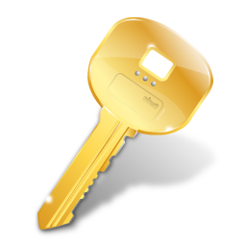
OAuth : Example of Authorization Code Flow
Azure AD OAuth Endpoints
Authorization Server
Resource Owner
John
2
John logs into Library client web app and chooses to show his currently checked out books.
Library App redirects John to OAuth authorize endpoint
John authenticates and grants consent
OAuth Server redirects John back to Library App with Authorization Code
Library App requests Access Token for Books web API from OAuth token endpoint
OAuth Server returns Access Token to Books API
Library App uses Access Token to authorize to Books API
3
T
C
5
1
4
6
Resource Server
Client App
7
Library
Web App
Books API
Notes:
Reference : https://docs.microsoft.com/en-us/azure/active-directory/develop/active-directory-protocols-oauth-code

Slide 12
Client Credentials Flow Summary
Azure AD Graph
John uses Client app (Address book app)
Client App (using its own creds : a shared secret or certificate) authenticates to OAuth Server (Azure AD)
OAuth Server provides access token to Client
Client calls Resource (Web Service) with access token in header
4
Client App
Resource Server
Address Book App
3
1
2
T
John
Resource Owner
Azure AD OAuth Endpoint
Authorization Server
Note: The client credentials grant type MUST only be used by confidential clients.
Notes:
Reference :
https://docs.microsoft.com/en-us/azure/active-directory/develop/active-directory-protocols-oauth-service-to-service
Scenario
The Oauth 2.0 client needs to access non-user specific data, on behalf of the client rather than the user
The Oauth 2.0 client can securely store key, used for authenticating the client
Example
User is using a Business Web App that reads his group membership from Azure Active Directory
Oauth 2.0 Roles:
Resource Owner: User
Client: Web Application
Resource Server: Microsoft Azure Active Directory
Resource: User’s Group Membership

Slide 13



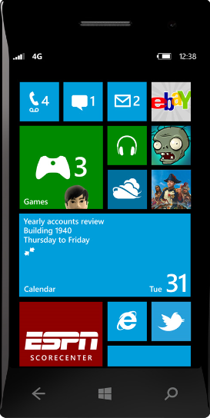


Resource Owner Password Credentials Flow Summary
Resource Owner
Resource Owner gives credentials to Client
Client uses credentials and to request access token from Authorization Server
Authorization Server validates the resource owner credentials, and returns access token
Client
OAuth 2.0
Authorization Server
Notes:
Reference: https://blogs.msdn.microsoft.com/wushuai/2016/09/25/resource-owner-password-credentials-grant-in-azure-ad-oauth/
Scenario
Client application is highly trusted (first-party application)
Example
User is using the official Facebook application for Windows Phone
Oauth 2.0 Roles:
Resource Owner: User
Client: Facebook Windows Phone Application
Resource Server: Facebook
Resource: User’s Facebook Content

Slide 14



Implicit Flow Summary
Resource Owner
OAuth 2.0
Authorization Server
Client redirects Resource Owner to Authorization Server.
Resource Owner authenticates and grants consent
Authorization Server redirects Resource Owner to the Client’s Server Component with the Access Token in URL fragment
Client’s Server Component returns script that extracts Access Token from the URL fragment
Client app is a client-side component of the browser (i.e. JavaScript or Adobe Flash)
JavaScript Component
(Browser)
Web Server Component
Notes:
Scenario
The Oauth 2.0 client is a client-side component of the browser (i.e. JavaScript or Adobe Flash)
Browser is strongly trusted
Example
User is using web app that has embedded JavaScript in the browser, which wants to access his/her photos on Facebook
Oauth 2.0 Roles:
Resource Owner: User
Client: Web Application (Server and JavaScript Components)
Resource Server: Facebook
Resource: User’s Facebook Photos

Slide 15
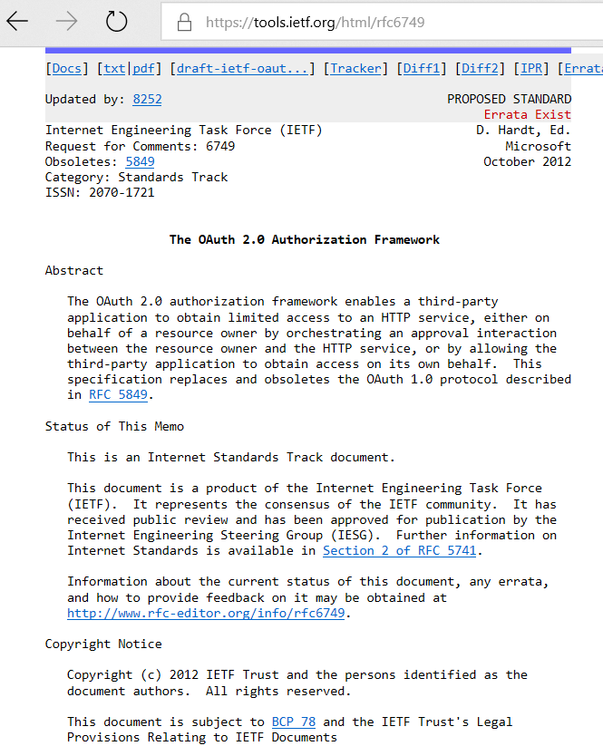
OAuth 2.0 Cheat Sheet
Date Ratified | October 2012
When to use it | Rich Client and Modern App scenarios
 | RESTful Web API access
Token Format | Agnostic, but primarily JWT
AD FS 2012 R2 Support | Yes : Only Supports Authorization Code flow
AD FS 2016 Support | Yes : Supports all OAuth 2.0 flows
Azure AD Support | Yes : Supports all OAuth 2.0 flows
Main Spec link | https://tools.ietf.org/html/rfc6749 https://aka.ms/Azure/Protocols

Slide 16
OpenID Connect Overview
OAuth 2.0 is not intended for authentication
Recall : OAuth 2.0 - delegate resource access rights to third parties
OpenID Connect defines an identity layer on top of OAuth 2.0
Uses Two OAuth 2.0 Flows:
Authorization Code Flow
Implicit Flow
Adds an ID Token to OAuth 2.0 exchange
Adds ability to request claims using an OAuth 2.0 access token
Ratified in Feb. 2014
Microsoft Co-Authored
Relies on an additional REST-based UserInfo endpoint (in addition of Authorization and Token endpoints )
For getting additional claims about a user
Authenticate with Access Token received from OpenID Connect Provider
Response returned in JSON.
Notes:
OpenID Connect - takes advantage of OAuth 2.0 flows for user-specific data
App requests identity token using a limited-use code

Slide 17



AuthN with the Authorization Code Flow
OpenID Connect Provider (OP)
7.a
A client registers with the OpenID Connect Provider (OP)
User browses to the Web App and initiates Log In
Web App redirects User to the OP
User authenticates to the OP and gives consent for the Web App to use his identity
The OpenID Connect Provider (OP)
builds the Authorization Code [C]
redirects the User back to the Web App with the Authorization Code
Web App sends Authorization Code to OP
The OpenID Connect Provider (OP)
Creates ID Token [I] and Access Token [T]
And sends back to Web App
Web App verifies ID Token
C
5.a
1. Client App Registration
T
I
4. Authenticate & Consent
7. b Returns ID Token & Access Token
6. Sends AuthZ code
C
3. AuthN Request
5.b AuthN Response
C
I
8.
T
User
2. Browse and Log In
Web Application

Slide 18
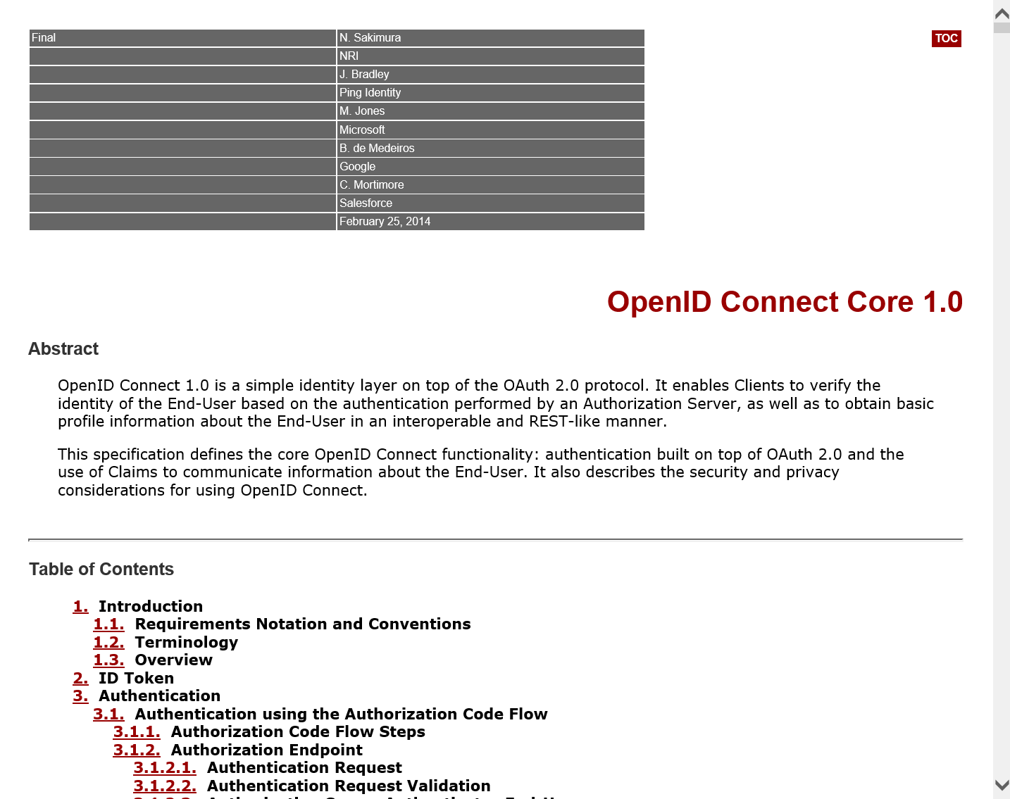
OpenID Connect Cheat Sheet
Date Ratified | Feb. 2014
When to use it | Web Sign In
 | When Consent is Needed
Token Format | JWT
AD FS 2012 R2 Support | No
AD FS 2016 Support | Yes
Azure AD Support | Yes
Main Spec link | http://openid.net/specs/openid-connect-core-1_0.html https://aka.ms/Azure/Protocols

Slide 19



SAML : Security Assertion Markup Language
Security Assertion Markup Language
XML protocol
OASIS standard (V1, v1.1 and V2)
Flexible and extensible
Framework to exchange security information between business partners
SAML 2.0 is an XML-based protocol that uses security tokens containing assertions to pass information about a principal (usually an end-user) between an identity provider and a web service (service provider).
SAML 2.0 enables web-based authentication and authorization scenarios including single sign-on (SSO).
ADVANTAGES
Platform Neutral
Improves Online Experience for Users
Supported by many SaaS applications
Strong commercial and open-source support
Organizations may extend like Shibboleth 1.3 or Liberty Alliance
Notes:
The single most important requirement that SAML addresses is web browser SSO.
The SSO solutions are common at the intranet level (using cookies, for example), but extending these solutions beyond the intranet has been problematic and has led to the proliferation of non-interoperable proprietary technologies.
The SAML specification defines three roles: the principal (typically a user), the identity provider (IdP), and the service provider (SP).
In the use case addressed by SAML, the principal requests a service from the service provider.
The service provider requests and obtains an identity assertion from the identity provider.
On the basis of this assertion, the service provider can make an access control decision.
In other words, it can decide whether to perform some service for the connected principal.
SAML does not specify the method of authentication at the identity provider; it may use a username and password, or other form of authentication, including multi-factor authentication.
A directory service, which allows users to log in with a user name and password, is a typical source of authentication tokens (for example, passwords) at an identity provider.
The popular Internet social networking services also provide identity services that in theory could be used to support SAML exchanges.

Slide 20
SAML : Use Cases and Core Concepts
Assertions:
Authentication, Attribute, and Authorization information
Protocol:
Request and Response elements for packaging assertions
Bindings:
How SAML protocols map onto standard messaging or communication protocols
Profiles:
How SAML protocols, bindings, and assertions combine to support a defined use case
Attribute-based authorization
Profiles
Bindings
Protocol
Web Single Sign-On
Assertions
Identity Federation
Notes:
Assertions: A package of security information about an identity. Also known as a token which is XML-based.
Protocols: Protocol refers to the format of the request and response elements:
Request / Response based
Defined in the SAML Core specification
Examples: Authentication Request, Artifact Resolution, Single Logout
Bindings: Associates a protocol message with a transport protocol.
Examples:
HTTP POST binding specifies how a SAML protocol message is sent through HTTP POST methods
SAML SOAP binding specifies how a SAML protocol message is sent through SOAP 1.1
Profiles: Describes how assertions, protocols, and bindings combine to form a scenario
Examples:
Web SSO Profile
AuthN Request Protocol

Slide 21
SAML WebSSO profile (scenario) overview
SAML Issuer (Azure AD)
A trust is established between the web application and the SAML Issuer
User browses to the web application
Web application detects that the user is not authenticated and redirects him to the SAML Issuer
User automatically browses to the SAML Issuer
User authenticates to the SAML Issuer
SAML Issuer :
builds the token
and passes it back to the user
User POSTs the token to the web application
The web application verifies the token
T
6.a
T
6.b Returns a SAML Token
5. Authenticate
1. Trust
4. Redirect ..
3. Redirect
2. Browse
T
User
7. POST the SAML token
Web application
T

Slide 22
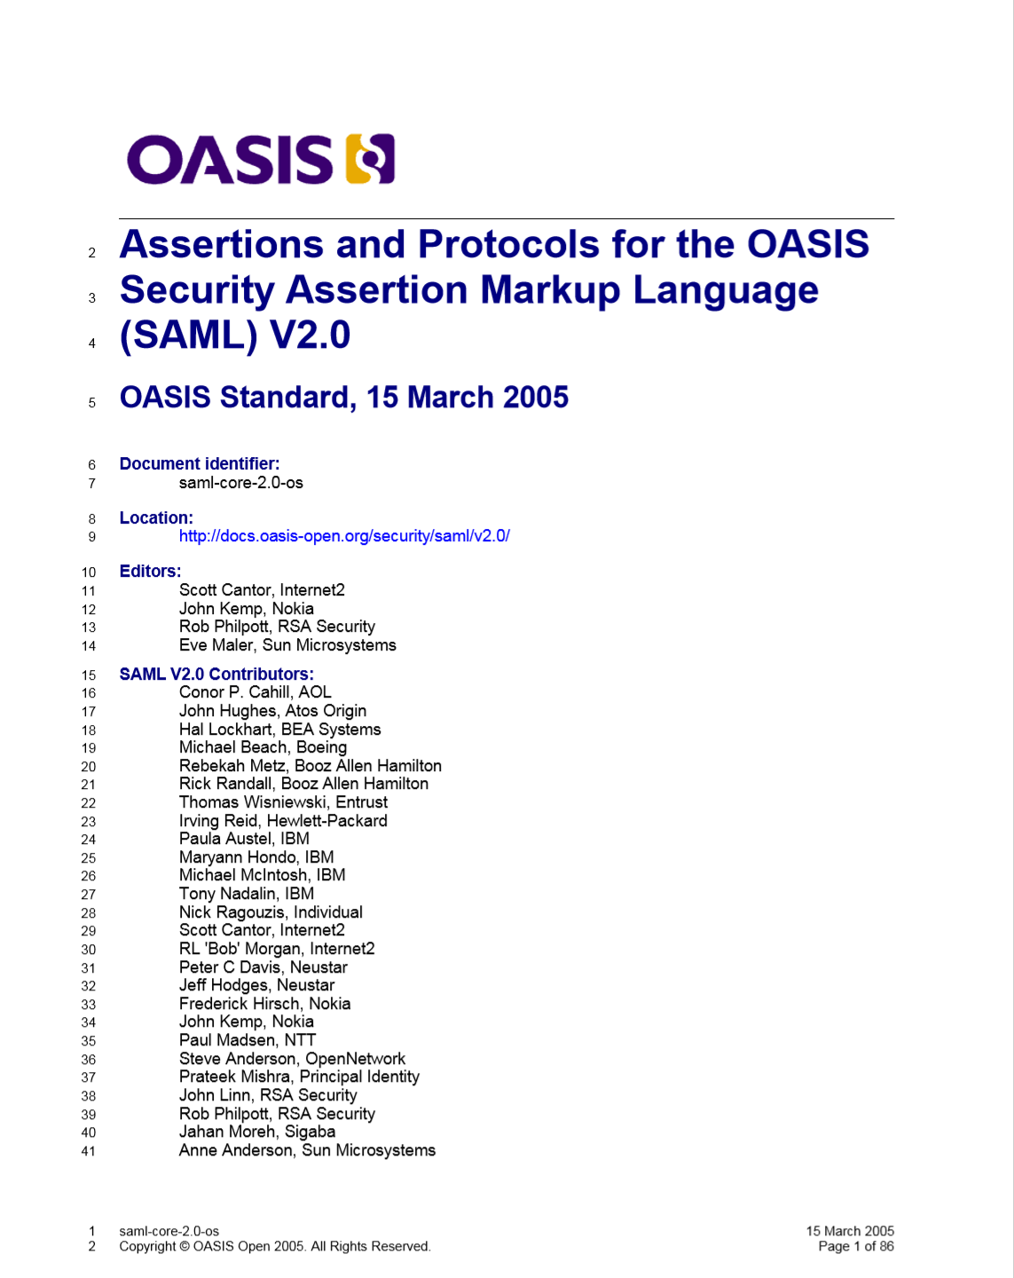
SAML 2.0 Cheat Sheet
Date Ratified | 2005 by OASIS
When to use it | Web Sign-In scenarios
 | Usually 3rd Party Web Apps
Token Format | XML
AD FS Support | Yes - Available in 2.x and 2012 R2
 | Issues SAML 1.1 and SAML 2.0 tokens
 | SAML 2.0 Protocol Only
Azure AD Support | Yes
 | Issues SAML 2.0 tokens only
 | SAML 2.0 Protocol Only
Main Spec Link | https://docs.oasis-open.org/security/saml/v2.0/saml-core-2.0-os.pdf https://aka.ms/Azure/Protocols

Slide 23
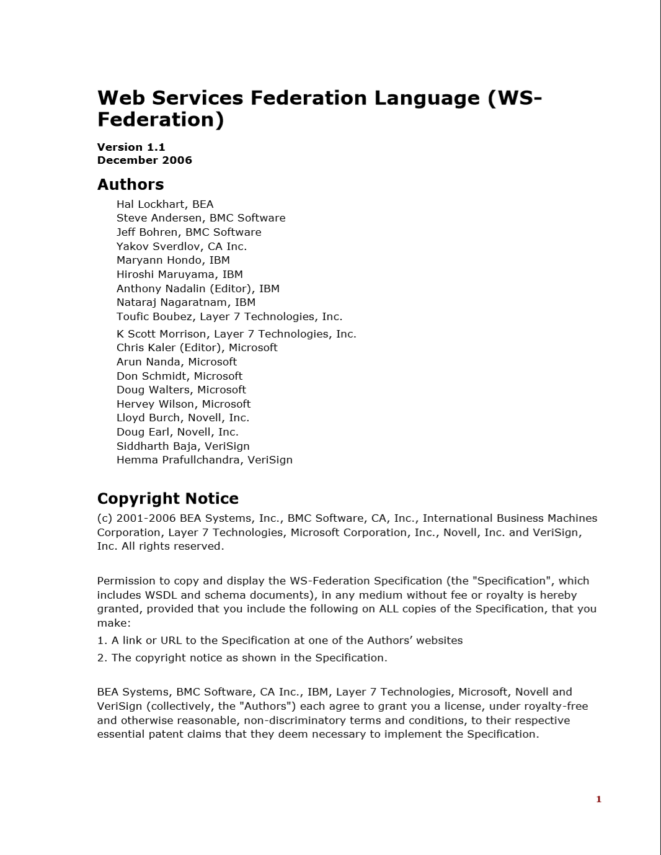
WS-Federation
Goal
Single Sign-On access across trust domain using identities without sharing them
Compassable Framework, Part if WS-Security
Defines how trust should be brokered between parties (through an STS)
Defines two profiles
Active Requestor Profile
Passive Requestor Profile
Token Agnostic
Other Components:
WS Policy
Specification used to allow web services to use XML to advice their policies
WS-Trust
Defines protocols to issue, renew, and cancel tokens
Specifications for requesting claims from a claims provider

Slide 24
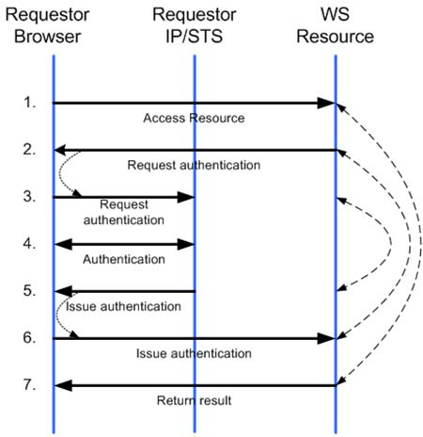
WS-Federation : Passive Requestor Profile
Passive Requestor Profile
Client is the web browser
RP creates token request
Relationship to SAML-P (SAML protocol)
Similar to SAML Web SSO Profile
Incompatible
Different request and response messages than SAML
No IdP-initiated use case
Notes:
SAML Web SSO
In the scenario, a web user either accesses a resource at a service provider, or accesses an identity provider such that the service provider and desired resource are understood or implicit. The web user authenticates (or has already authenticated) to the identity provider, which then produces an authentication assertion (possibly with input from the service provider) and the service provider consumes the assertion to establish a security context for the web user. During this process, a name identifier might also be established between the providers for the principal, subject to the parameters of the interaction and the consent of the parties.
IDP-Initiated Use case
In an IdP-initiated use case, the identity provider is configured with specialized links that refer to the desired service providers. These links actually refer to the local IdP's SSO service and pass parameters to the service identifying the remote SP. So instead of visiting the SP directly, the user accesses the IdP site and clicks on one of the links to gain access to the remote SP. This triggers the creation of a SAML assertion that, in this example, will be transported to the service provider using the HTTP POST binding.

Slide 25
WS-Federation Cheat Sheet
Date Ratified | 2006
When to use it | Web Sign-In scenarios
 | .NET Web Apps
Token Format | Agnostic – i.e. SAML, JWT, etc…
AD FS Support | Yes – All versions
Azure AD Support | Yes
Main specs link | http://specs.xmlsoap.org/ws/2006/12/federation/ http://specs.xmlsoap.org/ws/2006/12/federation/ws-federation.pdf https://aka.ms/Azure/Protocols

Slide 26


Token Format : Different Flavors of Tokens
SAML – Security Assertion Markup Language
XML-based
Very descriptive metadata
JWT – JSON Web Token
More easily human readable
Smaller token size
SWT – Simple Web Token
Form-encoded attribute/value pairs
Not very common
Kerberos
Some protocols are Token Agnostic
Some identity protocols are token agnostic
You can use whatever you want for a token

Slide 27
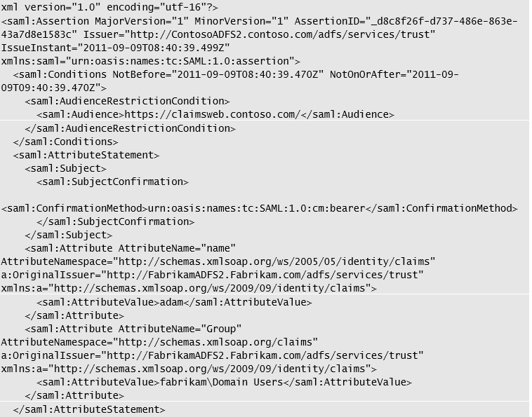
Example of SAML Token
SAML Version
Issuer
Validity Period
Where to use it
Attributes
Other elements like signature and auth form also listed

Slide 28
Anatomy of JWT Tokens
JWT = JSON Web Token
Uses JSON to represent claims
Designed for compactness
Easily transportable over HTTP
Query String Parameters
HTTP Headers
Not a replacement for SAML
JWT is less expensive (size and complexity)
Not as many options
Signing and Encryption
Defined in the header
Not required (could be secured by transport)
PlainText JWT
{"typ":"JWT", "alg":"HS256"}.
{"iss":"joe", "exp":1300819380, "http://example.com/is_root":true}
Signed and Encoded JWT
eyJ0eXAiOiJKV1QiLA0KICJhbGciOiJIUzI1NiJ9. eyJpc3MiOiJqb2UiLA0KICJleHAiOjEzMDA4MTkzODAsDQogImh0dHA6Ly9leGFtcGxlLmNvbS9pc19yb290Ijp0cnVlfQ.
dBjftJeZ4CVP-mB92K27uhbUJU1p1r_wW1gFWFOEjXk
Notes:
JSON Web Token (JWT) is a means of representing claims to be transferred between two parties. The claims in a JWT are encoded as a JSON object that is digitally signed using JSON Web Signature (JWS) and/or encrypted using JSON Web Encryption (JWE).
JSON (Java Script Object Notation), is an open standard that uses human readable text to transmit data objects consisting of attribute-value pairs, it is an alternative to XML.
JWTs represent a set of claims as a JSON object that is base64url encoded and digitally signed and/or encrypted. The JWT Claims Set represents this JSON object. As per its RFC the JSON object consists of zero or more name/value pairs (or members), where the names are strings and the values are arbitrary JSON values. These members are the claims represented by the JWT.
The member names within the JWT Claims Set are referred to as Claim Names. The corresponding values are referred to as Claim Values.
The bytes of the UTF-8 representation of the JWT Claims Set are signed in the manner described in JSON Web Signature (JWS) and/or encrypted in the manner described in JSON Web Encryption (JWE). The contents of the JWT Header describe the cryptographic operations applied to the JWT Claims Set. If the JWT Header is a JWS Header, the claims are signed. If the JWT Header is a JWE Header, the claims are encrypted.
A JWT is represented as the concatenation of the Encoded JWT Header, the JWT Second Part, and the JWT Third Part, in that order, with the parts being separated by period ('.') characters. When signed, the three parts of the JWT are the three parts of a JWS used to represent the JWT. When encrypted, the three parts of the JWT are the three parts of a JWE used to represent the JWT.

Slide 29
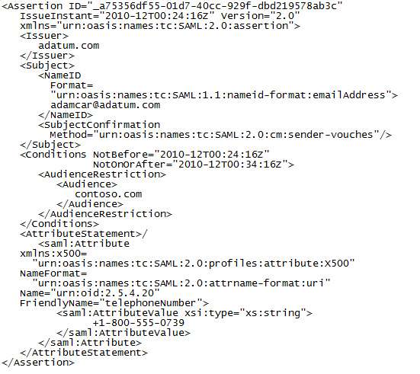
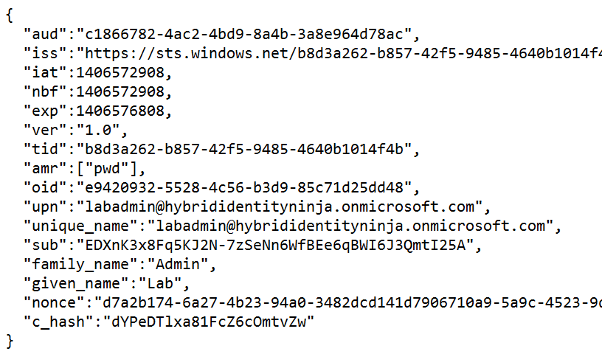
SAML Token vs JWT
SAML Assertion
JSON Web Token

Slide 30
Differences between Sign-In Protocols
Topic | SAML | OAuth | WS Federation
When to Use | Web Sign-In Usually Third-Party Apps | Rich and Modern Apps Restful Web API | Web Sign-In
Token Formats | XML | JWT | Agnostic (SAML, JWT)
Azure AD Support | Issues SAML 2.0 Tones Support for SAML 2.0 | Support for all OAuth 2.0 flows | Yes

Slide 31
Token types
Access Tokens
Used to access protected resources
Used for a specific combination of user, client, and resource
Cannot be revoked and valid until expire
Refresh Tokens
When resource is accessed, client receives refresh and access token
Refresh token used to access a new access token when one expires
Can be revoked
ID Tokens
Contain profile information about a user. Valid until Expire. Represented as JWT Tokens – contain claims
Session Tokens (SSO)
Cookie used for Keep-me-Singed-In (kmsi). Can be revoked
Persistent and on-persistent
Notes:
Don’t want to go too deep in this, but just provide the overview and like to explain in particular Access and Refresh tokens. The key point to note is that with applications that support Modern Authentication flows, once you login and get a Primary Refresh Token (PRT), then that can be used to SSO to other apps e.g. Office 365 without having to reauthenticate. The Oauth 2.0 flow uses Access and Refresh Tokens. Open ID Connect introduces ID Toe
ID Tokens
An ID token is a form of sign-in security token that your app receives when it performs authentication by using OpenID Connect. ID tokens are represented as JWTs, and they contain claims that you can use to sign the user in to your app. You can use the claims in an ID token in various ways. Typically, admins use ID tokens to display account information or to make access control decisions in an app.
Single sign-on session tokens
When a user authenticates with Azure AD and selects the Keep me signed in check box, a single sign-on session (SSO) is established with the user’s browser and Azure AD. The SSO token, in the form of a cookie, represents this session. Note that the SSO session token is not bound to a specific resource/client application. SSO session tokens can be revoked, and their validity is checked every time they are used.+
Azure AD uses two kinds of SSO session tokens: persistent and nonpersistent. Persistent session tokens are stored as persistent cookies by the browser. Nonpersistent session tokens are stored as session cookies. (Session cookies are destroyed when the browser is closed.)+
Nonpersistent session tokens have a lifetime of 24 hours. Persistent tokens have a lifetime of 180 days. Any time an SSO session token is used within its validity period, the validity period is extended another 24 hours or 180 days, depending on the token type. If an SSO session token is not used within its validity period, it is considered expired and is no longer accepted.
In Public Preview…Still?
You can specify the lifetime of a token issued by Azure Active Directory (Azure AD). You can set token lifetimes for all apps in your organization, for a multi-tenant (multi-organization) application, or for a specific service principal in your organization. https://docs.microsoft.com/en-us/azure/active-directory/active-directory-configurable-token-lifetimes
Reference
http://aka.ms/Azure/AD/Tokens
http://aka.ms/Azure/Tokens
Many of the tokens issued by the v2.0 endpoint are implemented as JSON Web Tokens (JWTs). A JWT is a compact, URL-safe way to transfer information between two parties. The information in a JWT is called a claim. It's an assertion of information about the bearer and subject of the token. The claims in a JWT are JavaScript Object Notation (JSON) objects that are encoded and serialized for transmission. Because the JWTs issued by the v2.0 endpoint are signed but not encrypted, you can easily inspect the contents of a JWT for debugging purposes. For more information about JWTs, see the JWT specification.

